Slide 1

Your target market
Whose actually gunna play your game

Slide 2
Some stats
As of 2019 there was around 30000 titles on the Steam library
10263 games released in 2020
197 new titles a week (28 a day)
Mobile store sits at around 400 a week
Staying on the front page requires a CPM (click per minute) ratio
"We'll just put our game on steam and see how it goes" really will not work

Slide 3
Our primary target audience is males who play video games aged 15 - 35
>:(

Slide 4
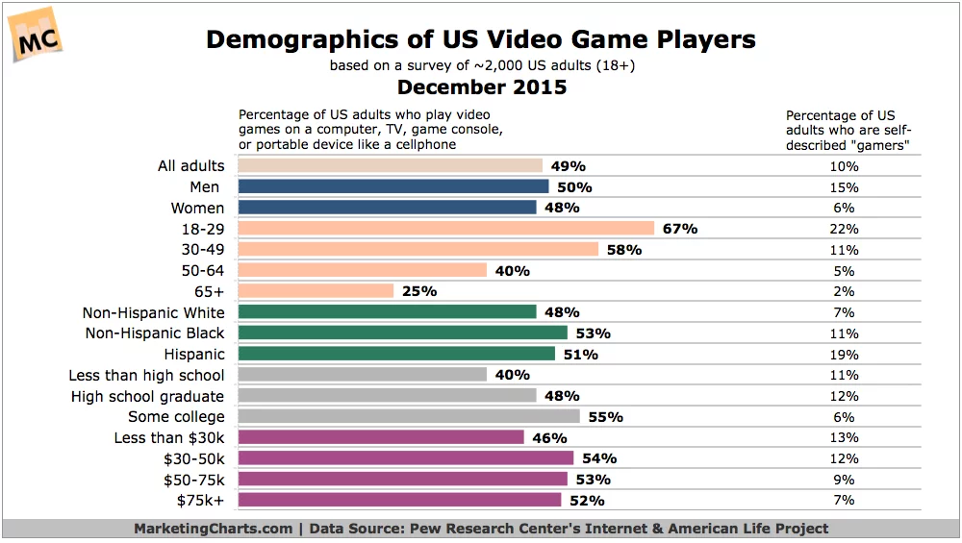

Slide 5
Finding your target audience?
Demographics alone don’t really tell you enough about who your game is for
https://www.gamasutra.com/blogs/JustinCarroll/20170313/258979/How_to_Research_Your_next_Games_Target_Audience_for_Free.php
Use similar titles to see who this target audience is
Using this data create a “Profile” or your “Model - Player” or "Persona"

Slide 6
Types of Players / Experiences
Casual
Competitive
Social
Escapist
Sports Sim
Lifestyle Sim
Masochistic
Meditative
Aesthetics
Serious (simulation, training)

Slide 7
Your Model player
What does the typical player look like?
What do they like about games?
What cultural values to they hold?
What social values to they hold?
What platforms would they own?
How would they communicate to others about your game?
What design decisions could be made to appeal to this player?

Slide 8
Make a persona
Make up an actual person, name, age, personality , address etc
Helps with the "empathize" phase of design
What motivates and drives this person?
What are their wants, needs, goals, emotions?
Combine personas and scenarios
Make multiple, and make sure these personas are not just copies of who is making the game!

Slide 9
Target Audience paired with Genres
What kind of people like FPS?
use gaming as a social interaction
use gaming as a way to compete
Like arcade style or realistic?
Individual or team oriented?
What kind of people like RPG?
Use gaming as a source of escape
Use gaming as way to tell stories
Self expression
adventure
Why are these genres appealing to these people?

Slide 10
Target Audience paired with devices
Mobile games
Casual games
Accessible and short play sessions
Pc games
Wide range of build options to accommodate for
Could potentially run very powerful games
Could be streamers or modders
Console (Xbox, PlayStation)
Expect a more commercial standard of games
Have more invested, intentional gaming session
Portable consoles (Switch)
Typically wants a title ported over from console
Accessible mobile playing experiences

Slide 11
Community and Games
Appealing to a demographic can be costly
Indie-Developers won't make sales off the general public but rather the community built around their game
Appealing to a niche community means stronger support and investment from that community
Word of mouth is one of the biggest sales-tool, but requires a "critical mass"
Community should be built as early as possible, and engaged with as much as possible
Have your community anticipate your release

